Slide 1

FINAL YEAR PROJECT PRESENTATION
Project Name:
PREDICTING STOCK MARKET MOVEMENT BY ANALYZING SENTIMENT IN NEWS HEADLINES
Group CS-G-21
Computer Science and Engineering
Mentor:
Mr. Rajeev Dixit
TEAM MEMBERS:
• Siddhant Mishra(CS-A)
• Saumya Pandey(CS-A)
• Ritika Singh(CS-A)

Slide 2
Predicting stock market movement by analyzing sentiment in news headlines
Initiative to help people and researchers understand stock market better

Slide 3
Problem statement :
Among the multiple factors that influence stock prices, and the major one is what’s happening around the globe(news), which is derived from the news.
Our objective is to analyze this feedback and predict its potential impact on the stock's price.

Slide 4
Objective Of This Project
The objective of this project is to help People predict stock prices using sentiment analysis on news.
This involves using natural language processing (NLP) techniques to analyze the sentiment of news (positive, negative, neutral) related to specific stocks or the stock market in general.
By gauging the sentiment expressed in these news headlines, we aim to develop a predictive model that can potentially provide insights into future stock price movements.

Slide 5
Idea Of this Project :
The idea is to make a tool using Machine Learning and python with the help of Natural Language Processing.
Unravel Sentiment-Price Relationship: The project uncover insights into the relationship between sentiment and stock movements. This could include identifying sentiment that strongly affects the price movements and when it doesn't.
Visualization of Results: Demonstrate the model's performance using confusion matrices. These visualizations can help convey the effectiveness of the model to stakeholders.

Slide 6
This project is for :
We are aiming to make an predictive model which will utilize sentiment analysis to forecast potential stock price movements.
This project aims to empower the general public with information that can help them make better investment decisions.
This will make it easier for us to understand the relationship between people's thoughts about a stock or company and its effect on the price.
Financial analysts, portfolio managers, and other financial professionals can use the insights to enhance their decision-making processes.

Slide 7
Technology & Libraries used :
Google Colab
Python
Flask
Html+CSS
Machine Learning algorithms - LSTM
Natural Language Processing - NLTK
Libraries - Pandas, Keras, Scikit-learn, TextBlob, Matplotlib and Seaborn
Classification Report, Confusion Matrix,Accuracy Score

Slide 8
A summary of what we have:
Problem Definition:
Clearly define the problem statement, which is sentiment analysis of financial news data.
Specify the goal of the analysis, such as predicting sentiment (positive, negative, or neutral) based on news descriptions.
Data Collection and Understanding:
Identify sources for financial news data, such as Kaggle.
Collect a diverse dataset of financial news articles along with their corresponding sentiment labels.
Understand the structure of the data, including the format of news articles, sentiment labels.
Data Preprocessing:
Clean the text data by removing any irrelevant information, such as special characters, HTML tags, or punctuation.
Tokenize the text data by splitting it into individual words or tokens.
Remove stop words (commonly occurring words that do not carry significant meaning) from the text.
Apply stemming or lemmatization to reduce words to their base forms.

Slide 9
Model Selection and Architecture:
Choose an appropriate machine learning model for sentiment analysis.
Such as LSTM (Long Short-Term Memory), which are well-suited for sequential data like text.
Design the architecture of the model, including the number of layers, type of activation functions, and regularization techniques.
Model Training:
Split the dataset into training, validation, and testing sets.
Train the sentiment analysis model on the training data using appropriate optimization algorithms and loss functions.
Monitor the model's performance.
Model Evaluation:
Evaluate the trained model's performance on the testing set using metrics such as accuracy and confusion matrix.
Analyze the model's predictions using confusion matrices to understand its strengths and weaknesses.

Slide 10
Model Deployment:
Deploy the trained sentiment analysis model in a production environment, such as a web application.
Monitor the model's performance over time and consider retraining it periodically with new data to maintain accuracy.
Model Representation using HTMl CSS and Flask:
Evaluated the model on the test dataset.
Calculated accuracy, confusion matrix, and classification report.
Plotted the confusion matrix heatmap and visualized the model architecture.

Slide 11
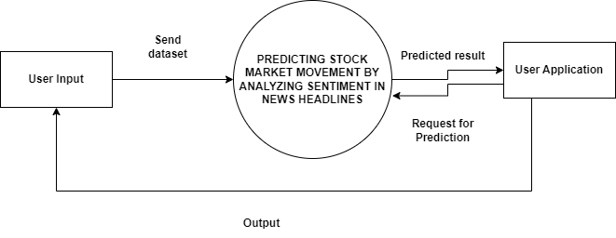
Data Flow Diagram
Level - 0 DFD

Slide 12
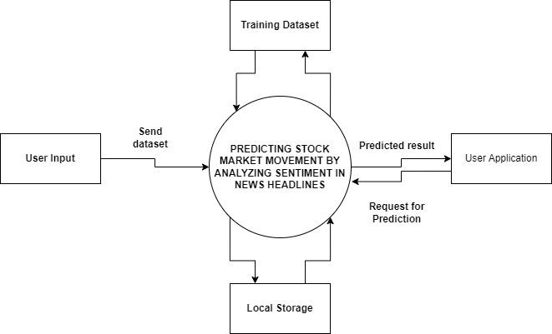
m
Level -1 DFD

Slide 13
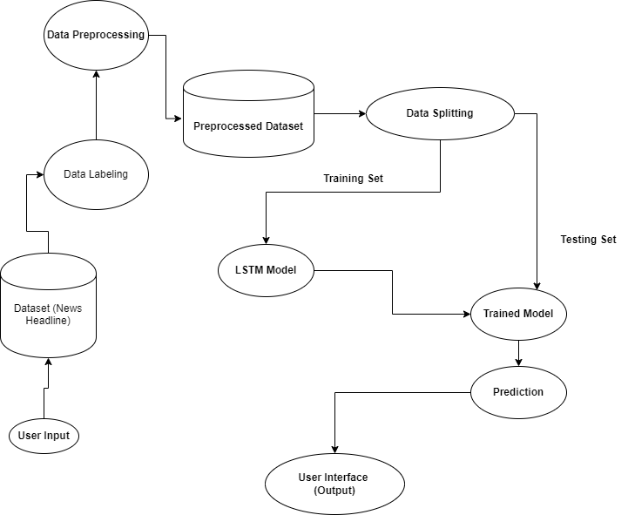
Level 2 DFD

Slide 14
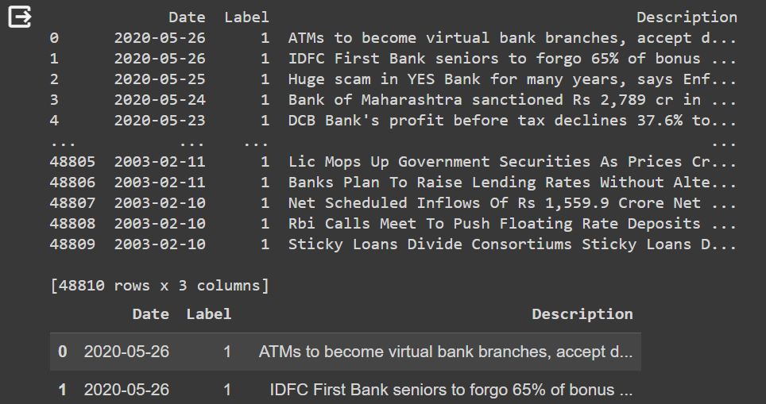
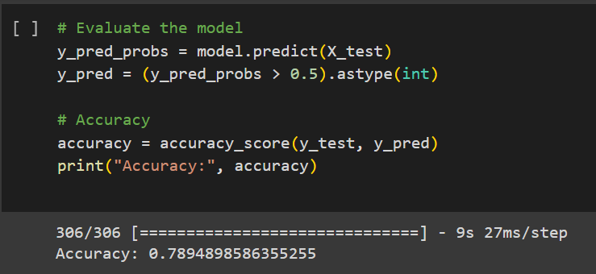
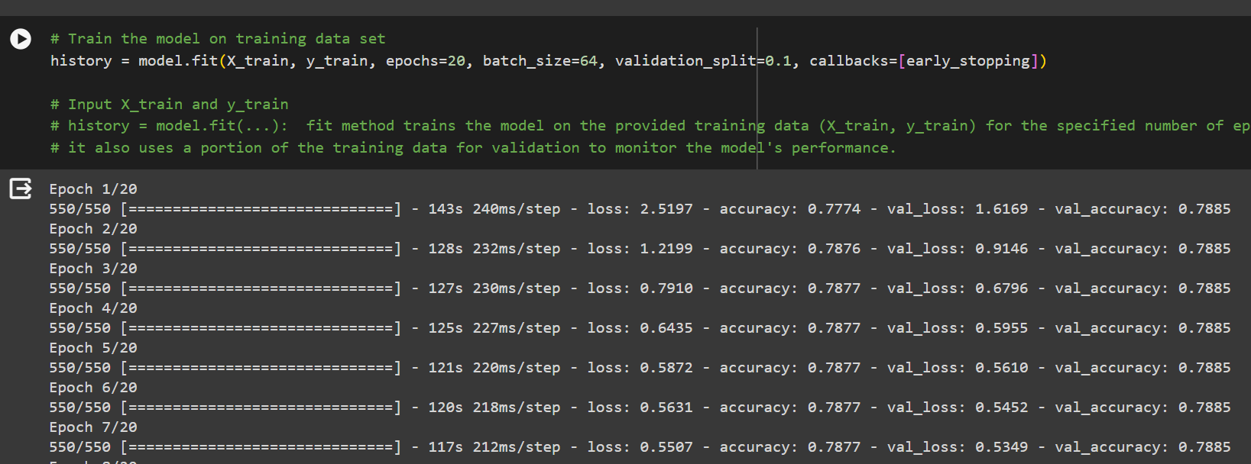
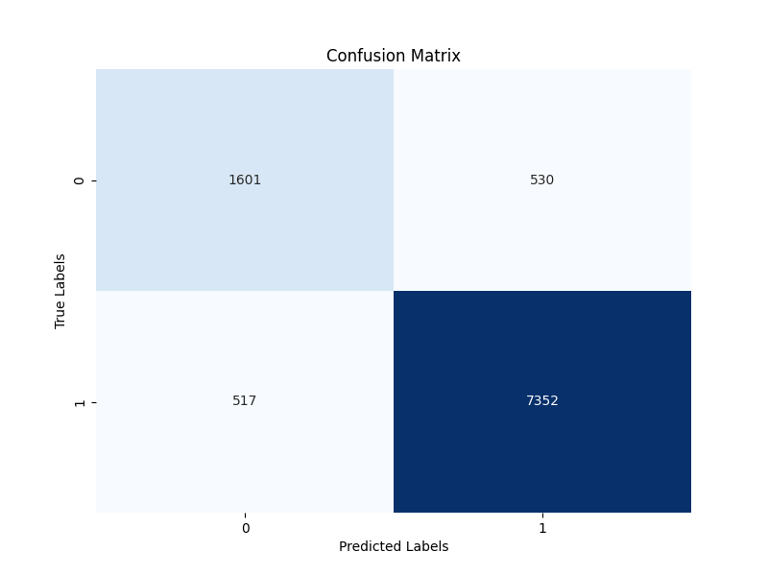
Results:

Slide 15
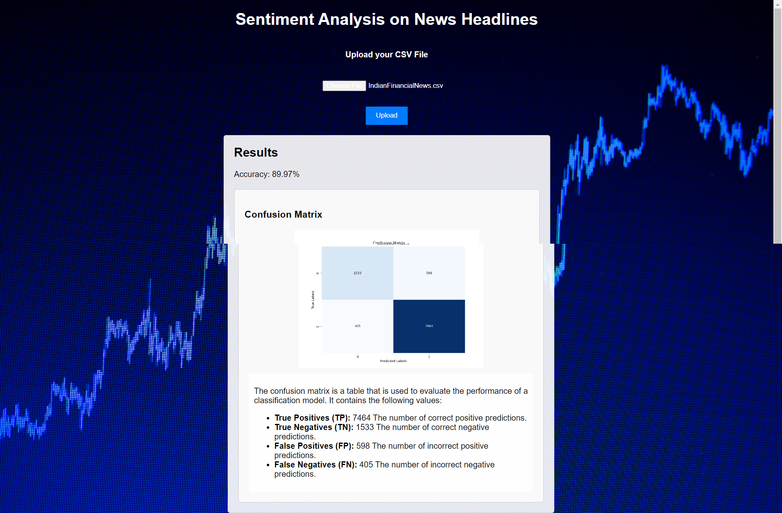

Slide 16
Conclusion :
In conclusion, this project of predicting stock prices using sentiment analysis on holds significant promise in providing valuable insights to investors, traders, and financial professionals.
By leveraging the power of natural language processing and machine learning, this project aims to bridge the gap between public sentiment and stock price movements, offering a unique perspective on market dynamics.

Slide 17
THANK YOU

